Slide 1

Presidential Initiative for Artificial Intelligence and Computing (PIAIC) A Nation Building Project
Zia U. Khan (Mobile: 0300-826-3374)
www.facebook.com/ziakhan
MS, MBA, MAC, MA, CPA, CMA
COO PIAIC
www.piaic.org
www.facebook.com/groups/piaic/

Slide 2
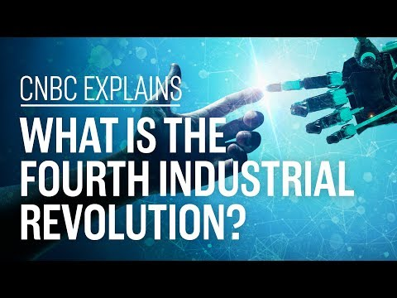

Slide 3
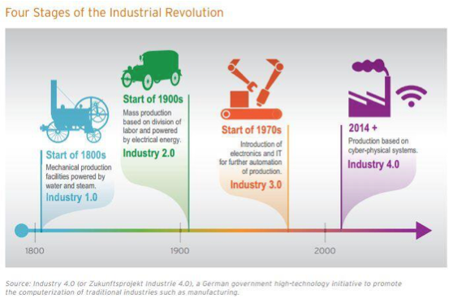

Slide 4
What is the Fourth Industrial Revolution?
Klaus Schwab, founder and executive chairman of the Geneva-based WEF, published a book in 2016 titled "The Fourth Industrial Revolution" and coined the term at the Davos meeting that year.
Schwab argued a technological revolution is underway "that is blurring the lines between the physical, digital and biological spheres."
Simply put, the Fourth Industrial Revolution refers to how technologies like artificial intelligence, autonomous vehicles and the internet of things are merging with humans' physical lives. Think of voice-activated assistants, facial ID recognition or digital health-care sensors.
Schwab argued these technological changes are drastically altering how individuals, companies and governments operate, ultimately leading to a societal transformation similar to previous industrial revolutions.
Notes:
Klaus Schwab, founder and executive chairman of the Geneva-based WEF, published a book in 2016 titled "The Fourth Industrial Revolution" and coined the term at the Davos meeting that year.
Schwab argued a technological revolution is underway "that is blurring the lines between the physical, digital and biological spheres."
Simply put, the Fourth Industrial Revolution refers to how technologies like artificial intelligence, autonomous vehicles and the internet of things are merging with humans' physical lives. Think of voice-activated assistants, facial ID recognition or digital health-care sensors.
Schwab argued these technological changes are drastically altering how individuals, companies and governments operate, ultimately leading to a societal transformation similar to previous industrial revolutions.

Slide 5
The first three industrial revolutions
Zvika Krieger, the head of technology policy and partnerships at WEF, told CNBC that there is a common theme among each of the industrial revolutions: the invention of a specific technology that changed society fundamentally.
The First Industrial Revolution started in Britain around 1760. It was powered by a major invention: the steam engine. The steam engine enabled new manufacturing processes, leading to the creation of factories.
The Second Industrial Revolution came roughly one century later and was characterized by mass production in new industries like steel, oil and electricity. The light bulb, telephone and internal combustion engine were some of the key inventions of this era.
The inventions of the semiconductor, personal computer and the internet marked the Third Industrial Revolution starting in the 1960s. This is also referred to as the "Digital Revolution."

Slide 6
Difference between Third and Fourth
Fourth Industrial Revolution is different from the third for two reasons: the gap between the digital, physical and biological worlds is shrinking, and technology is changing faster than ever.
For evidence of how quickly technological change is spreading, observe the adoption of the telephone. It took 75 years for 100 million people to get access to the telephone; the gaming app "Pokemon Go" hooked that many users in less than one month in 2016.

Slide 7
The Issues and Concerns
Some experts warn of a "winner-take-all economy," where high-skilled workers are rewarded with high pay, and the rest of workers are left behind.
A 2018 report by investment firm UBS found billionaires have driven almost 80 percent of the 40 main breakthrough innovations over the past four decades.
In 2016, Schwab predicted inequality would be the greatest societal concern associated with the Fourth Industrial Revolution.
"There has never been a time of greater promise, or one of greater potential peril"

Slide 8
Where do We Stand as a Nation?
We have not mastered even the second or third industrial revolution technologies let alone fourth industrial revolution (4IR) technologies.
Currently, due to financial constraints we can’t have billion dollar budgets for research and deployment.
Most of our educational institutions have funding and quality issues they are not able to teach properly let alone do research.
Startup and Incubation funding is non-existent.
We don’t have a National 4IR Strategy or Policy.

Slide 9

We are Facing an Existential Threat as a People and as a Nation
An existential threat is a threat to something’s very existence—when the continued being of something is at stake or in danger. It is used to describe threats to actual living things as well to non-living thing things, such as a country or an ideology.

Slide 10


Given the Seriousness of the Situation Presidential Initiative was Required: December 2018

Slide 11
PIAIC Strategy: Start a Grassroots 4IR Movement
One of the main competitive advantages of Pakistan is our young population, however, they lack the skills to compete in the high-tech global economy.
We should train hundreds of thousands of skilled 4IR developers and experts throughout Pakistan.
This will be the beginning of the transformation of Pakistan into a high-tech nation. It will also alleviate the severe unemployment of educated youth in Pakistan.

Slide 12
PIAIC Strategy: Adopt Leapfrog Strategy
Leapfrog strategy proposed by Andrew Ng (https://www.andrewng.org) a Chinese English computer scientist, executive, investor, and entrepreneur, who co-founded and led the Google Brain team and was also a VP & Chief Scientist at Baidu. Currently he is an adjunct professor at Stanford University.
He has created a strategy for developing countries that have fallen behind in the technology race. The idea is to skip over the intermediary technologies and leapfrog into the future by adopting AI and latest technologies. With this approach, it is possible to achieve exponential growth in a shorter period of time.

Slide 13
PIAIC Strategy: Focus on Selected Fourth Industrial Revolution (4IR) Technologies
Artificial Intelligence (AI)
Internet of Things (IoT)
Cyber Ops and Security
Cloud Native & Mobile Computing
Blockchain
5G and SDN & NFV for Networking
Quantum Computing
DevOps

Slide 14
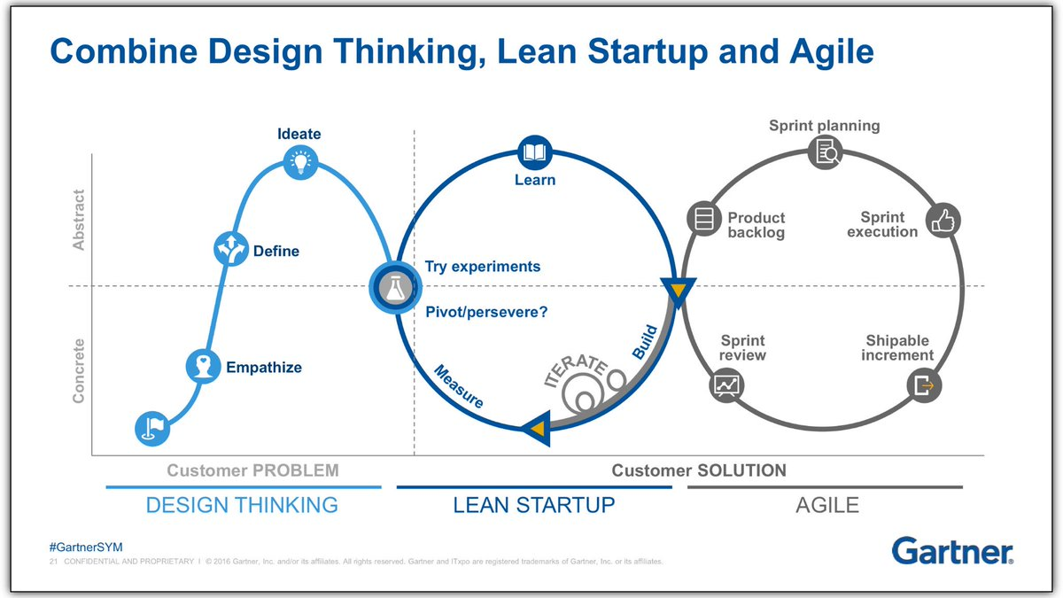
PIAIC Strategy: Focus on Innovation Leadership
Design Thinking
Lean Startup
Agile Project Management

Slide 15
PIAIC Strategy: Only Use Open Source Technologies
Use only Open Source Software and Hardware technologies.
This will allow us to implement them at an initial phase but later do advanced research and development.
This will also ensure security.
Open Source AI: TensorFlow and PyTorch
Open Source Programming: Python, Rust, Web Assembly and JavaScript
Open Source Operating Systems: Linux
Open Source Cloud: Kubernetes, KubeFlow, KubeEdge
Open Source DevOps: Terraform, Ansible, Jenkins, Prometheus
Open Source CPU: RISC-V

Slide 16

PIAIC Strategy: Tough Love with Students
Extensive Computer Based Quizzes and Exams
Those who are unwilling to work hard are removed from the program

Slide 17

PIAIC Strategy: Rigorous Selection of Faculty Members
All Faculty Members are selected on the basis of passing relevant International Skill Based Exams or Internal PIAIC Exams
All Faculty Members are required to continuously upgrade their skills and pass skill-based exams.

Slide 18

PIAIC Strategy: Hybrid Onsite and Online Teaching
A combination of E-learning and classroom teaching style
Onsite students attend classes and also watch E-learning content
Onsite classes only on weekends
Online only classes are also available

Slide 19
PIAIC Strategy: Low Fee and Big Class Size
Onsite student fee is Rs. 1,000 per month
Online student fee is Rs. 500 per month
Onsite classes are held in Auditoriums (USA State Universities Model)
Students bring their own laptops in classes (BYOD)
During first quarter 3 hours of classes per week
After first quarter 8 hours (Technical: 4 + Innovation: 4) of classes per week
All students are provided E-learning content on the PIAIC Portal
Main Faculty Members are paid Rs. 3,000 per hour. TA’s also deployed in classes.

Slide 20

PIAIC Strategy:
No Direct Financial Handling
Student Fee is collected and disbursed by the most trusted NGO in Pakistan

Slide 21
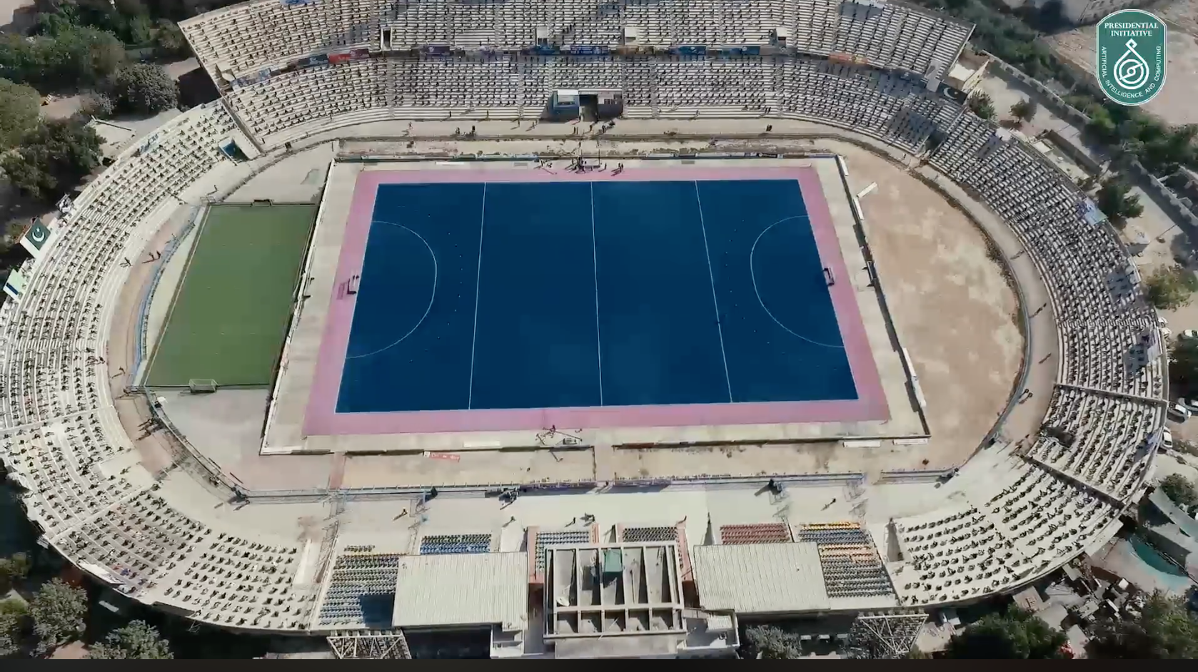
January 20 & 27, 2019 Three PIAIC Entrance Exams at Abdul Sattar Edhi Hockey Stadium, Karachi

Slide 22
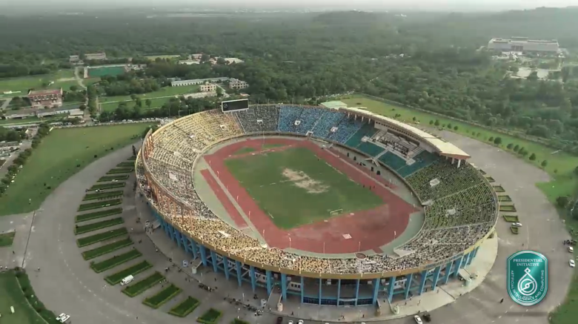
August 5, 2019: PIAIC Entrance Exam at Jinnah Sports Complex, Islamabad

Slide 23
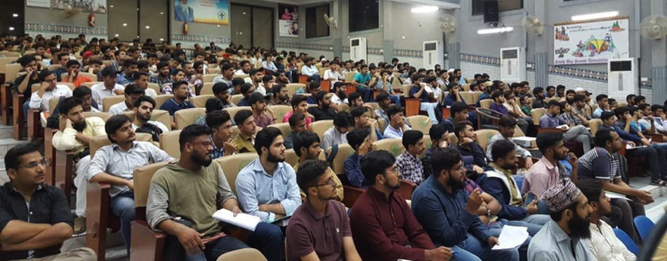
Classes in Full Swing

Slide 24
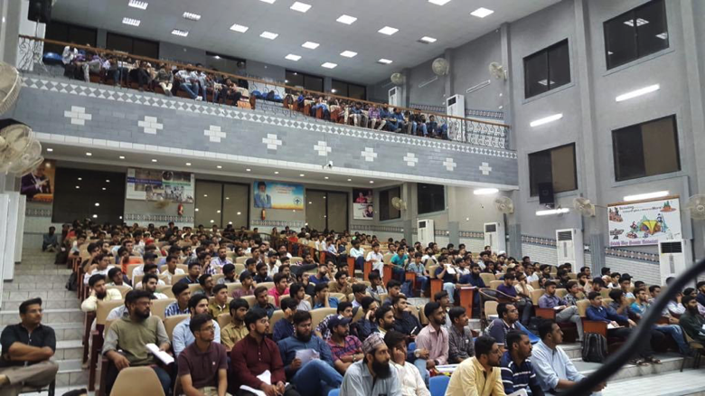

Slide 25
PIAIC Overview
50,000+ professionals and students have appeared in PIAIC Entrance Exams in Karachi, Islamabad, and Faisalabad.
20,000+ students taking onsite classes and/or studying online in Karachi, Islamabad, and Faisalabad.
Hundred of hours of E-learning content created and viewed by thousands
Over 1 Million views of videos on PIAIC Student Portal

Slide 26
Expansion Plan
Year 1 - 2019 (3 locations): Karachi, Islamabad, and Faisalabad
Year 2 - 2020 (10 locations): Sialkot, Lahore, Peshawar, Hyderabad, Multan, Sukkur, Quetta, Abbottabad, Muzaffarabad, and Gilgit
Year 3 (14 locations): Gujranwala, Bahawalpur, Mardan, Larkana, Nawabshah, Sargodha, Mingora, Kohat, Dera Ismail Khan, Khuzdar, Chaman, Gwadar, Mirpur, Poonch, and Skardu

Slide 27
PIAIC AI Program of Study
Technical Track
Quarter I:
AI for Everyone
Python
Quarter II:
Numpy
Pandas
Tensorflow
Quarter III:
Advanced Deep Learning with Tensorflow
Quarter IV:
Building Smart Applications
Innovation Leadership Track (Starts in 2nd Quarter)
Quarter I:
Design Thinking
Agile Project Management
Lean Startup
Quarter II:
DevOps, Git, Docker
Terraform, Ansible
Jenkins, Prometheus
Quarter III:
Lean UX
Designing Apps
Designing Bots

Slide 28
PIAIC Cloud Native and Mobile Web Apps Program of Study
Technical Track
Quarter I:
Linux
Docker
Kubernetes
Quarter II:
React
JAMstack
Quarter III:
MERN Stack
Quarter IV:
Multi Cloud
Innovation Leadership Track (Starts in 2nd Quarter)
Quarter I:
Design Thinking
Agile Project Management
Lean Startup
Quarter II:
DevOps, Git, Docker
Terraform, Ansible
Jenkins, Prometheus
Quarter III:
Lean UX
Designing Apps
Designing Bots

Slide 29
PIAIC IoT Program of Study
Technical Track
Quarter I:
Systems Programming using Rust
Quarter II:
Embedded Programing using Rust
Quarter III:
Async and Micro Services using Rust
Quarter IV:
Artificial Intelligence of Things and Bots
Innovation Leadership Track (Starts in 2nd Quarter)
Quarter I:
Design Thinking
Agile Project Management
Lean Startup
Quarter II:
DevOps, Git, Docker
Terraform, Ansible
Jenkins, Prometheus
Quarter III:
Lean UX
Designing Apps
Designing Bots

Slide 30
PIAIC Quantum Computing Program of Study
Technical Track
Quarter I:
Fundamentals of Programming a QPU
Quarter II:
Building QPU Applications
Quarter III:
In Depth Qiskit Quantum Computing
Quarter IV:
Applications in Finance, AI, Chemistry, and Gaming
Innovation Leadership Track (Starts in 2nd Quarter)
Quarter I:
Design Thinking
Agile Project Management
Lean Startup
Quarter II:
DevOps, Git, Docker
Terraform, Ansible
Jenkins, Prometheus
Quarter III:
Lean UX
Designing Apps
Designing Bots

Slide 31
PIAIC 5G and Software Defined Networking Program of Study
Technical Track
Quarter I:
Fundamentals of Core Networking and 5G Architecture
Quarter II:
Advanced Core Networking and Python Programming
Quarter III:
Network Programmability and 5G Architecture
Quarter IV:
Network Programmability & Cloud Native Computing
Innovation Leadership Track (Starts in 2nd Quarter)
Quarter I:
Design Thinking
Agile Project Management
Lean Startup
Quarter II:
DevOps, Git, Docker
Terraform, Ansible
Jenkins, Prometheus
Quarter III:
Lean UX
Designing Apps
Designing Bots

Slide 32
PIAIC Cyber Ops and Security Program of Study
Technical Track
Quarter I:
Fundamentals of Core Networking & Security
Quarter II:
Advanced Core Networking and Python Programming
Quarter III:
Core Security & Cryptography
Quarter IV:
Network Programmability & Security Tools
Innovation Leadership Track (Starts in 2nd Quarter)
Quarter I:
Design Thinking
Agile Project Management
Lean Startup
Quarter II:
DevOps, Git, Docker
Terraform, Ansible
Jenkins, Prometheus
Quarter III:
Lean UX
Designing Apps
Designing Bots

Slide 33
PIAIC Blockchain Program of Study
Technical Track
Quarter I:
Foundations of Blockchain
Quarter II:
Smart Contract Development
Quarter III:
Dapp Development
Quarter IV:
Advanced Blockchain Topics
Innovation Leadership Track (Starts in 2nd Quarter)
Quarter I:
Design Thinking
Agile Project Management
Lean Startup
Quarter II:
DevOps, Git, Docker
Terraform, Ansible
Jenkins, Prometheus
Quarter III:
Lean UX
Designing Apps
Designing Bots

Slide 34
NEXT PHASE
Setup 4IR Incubators, Startups and Freelancing Centers All Across Pakistan thru Collaborations & Partnerships
Open Talent Marketing Offices in Silicon Valley, New York, London, Beijing, and China (Nanjing) Software Valley
Start Programs in Other Countries

Slide 35
AVOID NATO
We should avoid No Action Talk Only
TOGETHER LET US EXCEL AND SHINE IN THIS FOURTH INDUSTRIAL REVOLUTION (4IR)
www.piaic.org

